Slide 1
EPISTATIC GENE INTRACTION

Slide 2


Introduction
Chemical Interpretation
Kinds of Epistasis
(і) Dominant Epistasis.
Recessive epistasis
Duplicate Recessive Genes
Duplicate Dominant Genes
Duplicate Genes with Cumulative Effect
Dominant Recessive Interaction
References

Slide 3













Epistasis is Greek word meaning standing over.
It was first used in 1909 by Bateson to describe a masking effect.
An interaction between a pair of loci, in which the phenotypic effect of one locus depends on the genotype at the second locus.
Genes whose phenotype are
  Expressed-epistatic
  altered or suppressed-hypostatic

Slide 4

Difference between dominance and epistasis
Dominance | Epistasis
Involves intra-allelic gene interaction. | Involves inter-allelic gene interaction.
One allele hides the effect of other allele at the same gene pair. | One gene hides the effect of other gene at different gene loci.

Slide 5




Chemical interpretation:
A gene is a chemical determiner.
Gene products interact with the environment and factors such as temperature, light, hormones and enzymes.
If there is any problem or mutation in the intermediates, it can lead to another phenotype and hence disturb the Mendelian ratios.

Slide 6
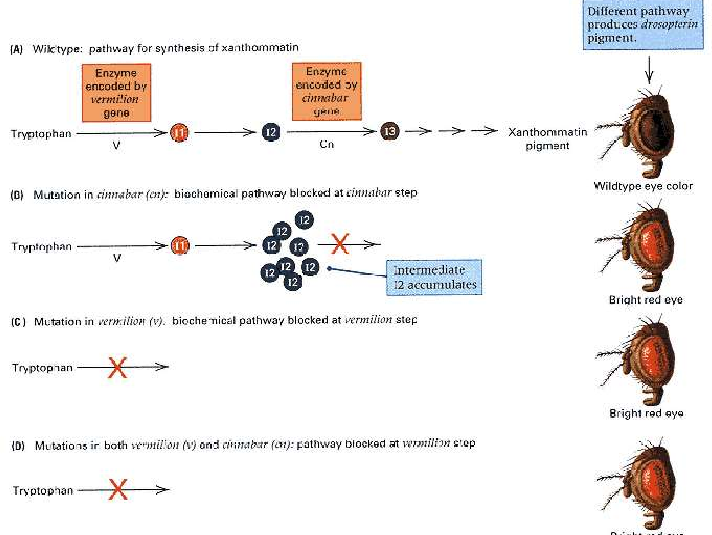

Slide 7

Example
 Effects of two genes pigmentation in Drosophila.
that function in eye
The genes are vermilion (v) and cinnabar (cn).
Flies that are mutant for cn lack xanthommatin. They have bright red eyes because of the drosopterin.
Mutant v flies also lack xanthommatin but for a different reason. In these flies the pathway is blocked because there is no functional V enzyme.

Slide 8

Kinds of Epistatic Interactions

In epistasis less than four phenotypes appear in F2.
(і) Dominant Epistasis. (12:3:1)
Recessive epistasis.(9:3:4)(Supplementary interaction)
Duplicate Recessive Genes (9:7) (Complementary Genes)
Duplicate Dominant Genes. (15:1)
Duplicate Genes with Cumulative Effect (9:6:1)
Dominant Recessive Interaction (13:3)

Slide 9

Dominant Epistasis. (12:3:1)
Dominant allele (eg.,A) of one gene hides the effect of allele of another gene (eg., B) and expresses itself phenotypically.
The B allele (hypostatic) will be expressed only when gene locus A contains two recessive (aa) alleles.
Thus, the genotype AA BB or Aa Bb and AA bb or Aa bb
produce the same phenotype
genotype aa BB or aa Bb and aa bb produce two additional phenotype.
This type of dominant epistasis modifies the classical ratio of 9:3:3:1 into 12:3:1

Slide 10
Epistatic alleles | Hypostatic alleles | Phenotypic Expression
aa | bb | b
aa | BB, Bb | B
AA, Aa | Bb, Bb, bb | A

Slide 11

Example:
Studied in summer squash (Cucurbita pepo)
Common fruit colors-white,yellow &green
White (W) is dominant over colored squash
Yellow (Y) is dominant over green squash
Pure breeding white fruited variety is crossed with the double recessive green variety,F1 hybrids are all white
When the hybrids are selfed-white, yellow &green fruited plants arise in the ratio of 12:3:1

Slide 12
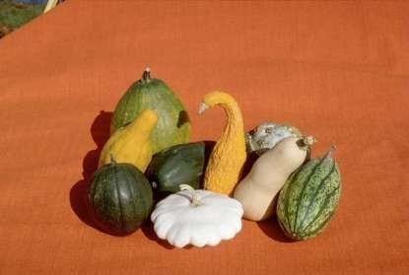
The effect of
dominant gene ’Y’ is masked by the
dominant gene ’W’ (epistatic gene)
P WWYY X wwyy (white) ↓ (green)
F1 WwYy (white) (selfed)
F2
White:Yellow:Green
12 : 3 : 1
♂/♀ | WY | Wy | wY | wy
WY | WWY Y | WWY y | WwY Y | Ww Yy
Wy | WWY y | WWyy | WwYy | Wwy y
wY | WwY Y | WwYy | wwYY | wwY y
wy | WwYy | Wwyy | wwYy | wwy y

Slide 13


Recessive epistasis. (9:3:4) (Supplementary interaction)
Recessive allele (aa) of one gene locus hides the effect of another gene locus (BB, Bb or bb) and expresses itself phenotypically.
The alleles of B locus express themselves only when epistatic locus has dominant alleles (eg., AA or Aa).
This will modify the ratio 9:3:3:1 to ratio 9:3:4

Slide 14
Epistatic alleles | Hypostatic alleles | Phenotypic Expression
aa | BB, Bb, bb | a
AA, Aa | BB, Bb | B
AA, Aa | bb | b

Slide 15


In horses, brown coat color (B) is dominant over
tan (b).
However, how that gene is expressed in the phenotype is dependent on a second gene that controls the deposition of pigment in hair.
The dominant gene (C) codes for the presence of pigment in hair, whereas the recessive gene (c) codes for the absence of pigment.

Slide 16
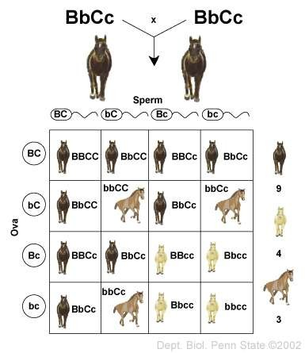

Slide 17

Duplicate Recessive Genes (9:7) (Complementary Genes)
Both the genes loci have homozygous recessive alleles and both of them produce identical phenotype.
Both dominant alleles are necessary to produce a different phenotype. e.g.: AABB, AaBB, AaBb, in all these combinations.
Both the dominant alleles (A and B) are present and they will produce a different phenotype.
Whereas aaBB or bbAA, in which the other dominant allele is absent, produces the normal phenotype.

Slide 18
Epistatic alleles | Hypostatic alleles | Phenotypic Expression
aa | BB, Bb, bb | No phenotype production
AA, Aa, aa | bb
AA, Aa | BB, Bb | Phenotype due to dominant

Slide 19
 Bateson and Punnett observed that when two white flowered varieties of sweet pea, Lathyrus odoratus were crossed, F₁ progeny had coloured flowers. When F₁ was selfed, the F₂ ratio showed the presence of both coloured and white flowered varieties in the ratio 9:7.
 In man, deaf mutism is complementary gene dependent, depending upon two dominant genes A and B, the presence of both of them is responsible for normal hearing and speech.

Slide 20
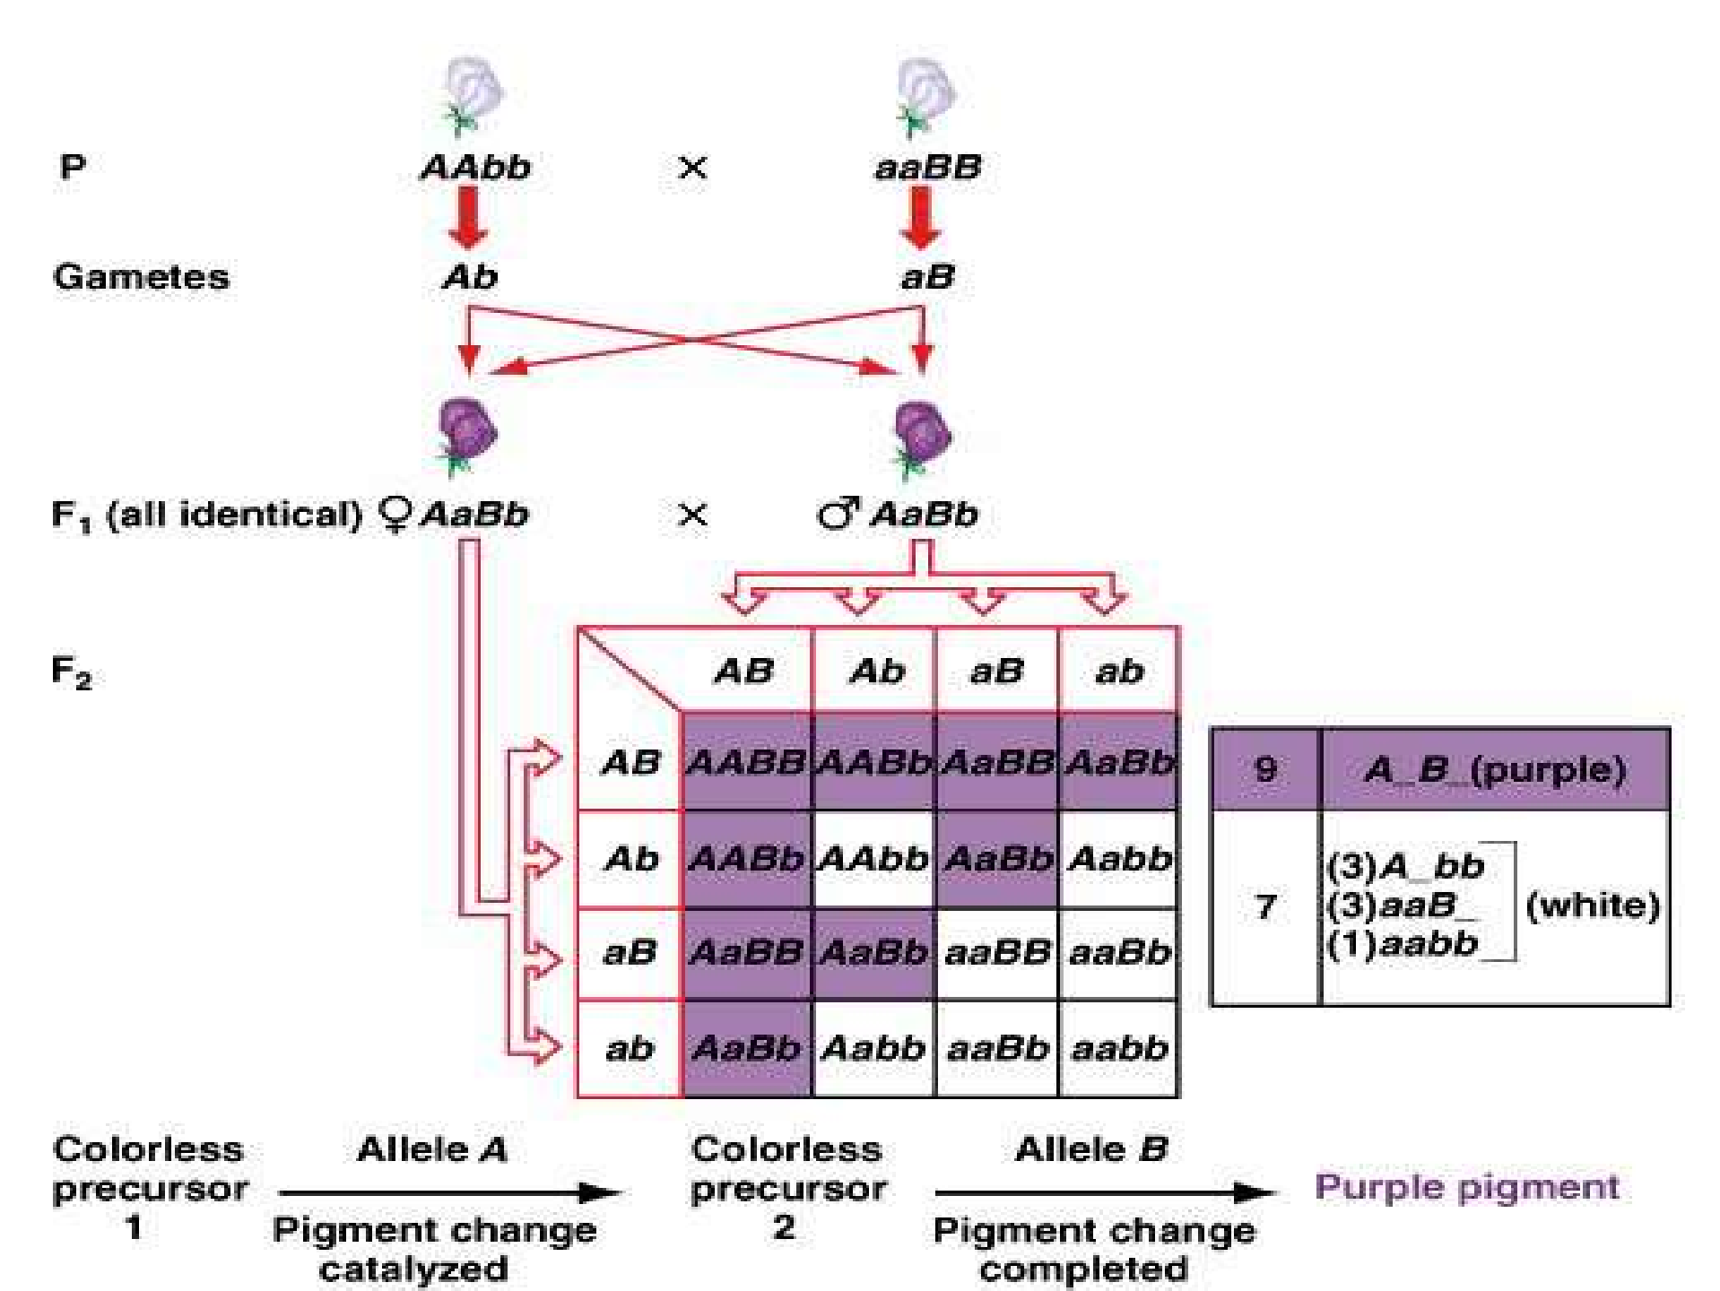

Slide 21
 In this case dominant alleles on both locus are required hence wherever A and B both are present they result into purple effect masking the white.
 This is because A and B alleles modified the colorless precursor by showing their effects

Slide 22


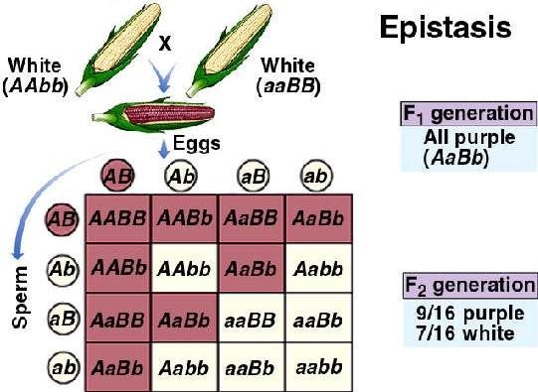

Slide 23
The purple pigment in corn requires that two enzymes (controlled by two dominant alleles) must be active for the pigment to form.
Two white varieties of corn showing the genotypes AAbb and aaBB, will produce a ratio of 9/16 purple and 7/16 white ears, depending upon the nine
different possible
arrangements of alleles) for
the these
chromosomes (and characteristics.

Slide 24

Duplicate Dominant Genes. (15:1)
The dominant alleles of both the genes produce the same
phenotypic effect giving the ratio 15:1.
At least one of the dominant allele is necessary for the phenotypic effect. e.g. AABB, AaBb, Aabb, aaBB, aaBbgive one phenotype.
In the absence of all the dominant genes (only in case of aabb), the recessive phenotype will be expressed.
The duplicate genes are also called pseudoalleles

Slide 25
Phenotypic expression
Epistatic alleles
Hypostatic alleles
Another phenotype
aa
bb
Same phenotype
aa
BB, Bb
AA, Aa
bb
AA, Aa
Bb, Bb

Slide 26
 As observed by G.H.Shull, the seed capsules of Shepherd’s purse (genus Capsella) occur in two different shapes,
i.e. triangular and top shaped.
When F₁ individuals were self crossed, the F₂ generation showed plants with triangular and top shaped capsules in the ratio 15:1
(A and B) would produce plants with triangular-shaped capsules.
aabb would produce plants with top shaped capsules.F₂
phenotypic ratio 15(triangular) 1(Top shaped).

Slide 27
AaBb (triangular)
 P : | AABB | × | aabb
 | (triangular) |  | (top-shaped)
F₁ :
AB
Ab
AABb
(triangular) AAbb (triangular) AaBb (triangular) Aabb (triangular)
aB
AaBB
(triangular) AaBb (triangular) aaBB (triangular) aaBb (triangular)
ab
AaBb (triangular) Aabb (triangular) aaBb (triangular) aabb
(top-shape)
AABB
(triangular) AABb
(triangular) AaBB
(triangular) AaBb
(triangular)
AB
Ab
aB
Ab

Slide 28


Duplicate Genes with Cumulative Effect. (9:6:1)
Both the dominant non allelic alleles, when present together, give a new phenotype, but when allowed to express independently, they give their own phenotypic expression separately.
In the absence of any dominant allele, the recessive allele is expressed.

Slide 29
Epistatic alleles | Hypostatic alleles | Phenotypic expression
aa | bb | Neither a nor b
aa | BB, Bb | B only
AA,Aa | bb | A only
AA,Aa | Bb, Bb | A+B mutually supplement

Slide 30
 In pigs S and s are allelic genes;
S giving sandy colour
ss giving white colour.
A non-allelic gene R also gives sandy colour (same as S) but when both the dominant genes interact together, they give red colour.
Non-allelic gene does not interact with ss

Slide 31
P : | SSrr | × | ssRR
 | (sand |  | (sandy)
SsRr (red)
Sr
SSRr
(red) SSrr (sandy) SsRr (red) Ssrr (sandy)
F₁ :
SR
SSRR
(red) SSRr
(red) SsRR
(red)
SsRr (red)
sR
SsRR
(red) SsRr (red) ssRR (sandy) ssRr (sandy)
sr
SsRr (red) Ssrr (sandy) ssRr (sandy) ssrr (white)
SR
F :
2
Sr
sR
Sr

Slide 32
Dominant Recessive Interaction (13:3)
The dominant allele (A), either in homozygous or heterozygous condition, of one gene and the homozygous recessive allele (bb) of other gene produces the same phenotype.
In F₂ generation, progenies having A (homozygous or heterozygous) or bb (homozygous) will not allow the C gene to be expressed.
Genotype AABB, AABb, AaBb and Aabb produce same phenotype and the genotype aaBB, aaBb and aabb produce another but same phenotype.

Slide 33
Epistatic alleles | Hypostatic alleles | Phenotypic expression
aa | Bb, BB, bb | a doesn’t inhabit B or b
AA, Aa | Bb, Bb , bb | A inhibit B or b

Slide 34
In Leghorn fowl, the white colour of feather is formed by CCII (due to the presence of epistatic gene I).
Similarly in Plymouth Rock fowl the white colour of feather is formed by ccii (due to the absence of dominant C gene).
Therefore C is suppressed by inhibitor gene both in dominant (I) and recessive (ii) condition.

Slide 35
 P :
CCII
(White Leghorn)
×
ccii
(White Plymouth Rock)
 F₁ :
CcIi (white)
Ci
CCIi
(white) CCii (colored) CcIi (white) Ccii (colored)
cI
CcII
(white) CcIi (white) ccII (white) ccIi (white)
ci
CcIi (white) Ccii (colored) ccIi (white) ccii (white)
CI
CCII
(white)
CCIi
(white) CcII
(white) CcIi (white)
CI
Ci
cI
ci

Slide 36

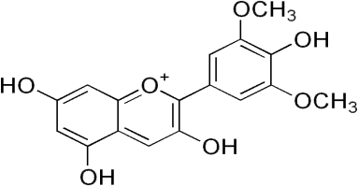
Example:
Interaction involves an inhibitory factor which by itself has no phenotypic effect
But, when present in the dominant form prevents or
inhibits the expression of another dominant gene
eg :.Malvidin in primula flowers
  Malvidin is a O-Methylated anthocyanin responsible for the blue pigments in Primula polyanthus plant

Slide 37
Synthesis of malvidin (blue) is controlled by gene K
In recessive state(k), malvidin is not synthesized
Production is suppressed by gene D, found at completely different locus
D allele is dominant to K allele

Slide 38
KKdd (blue)
x kkDD (white)
↓
KkDd (selfed) (white)
↓
♂/♀ | KD | Kd | kD | kd
KD | KKD D | KKD d | KkD D | KkDd
Kd | KKD d | KKdd | KkDd | Kkdd
kD | KkD D | KkDd | kkDD | kkDd
kd | KkDd | Kkdd | kkDd | kkdd

Slide 39
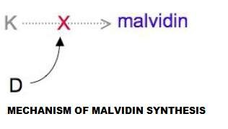
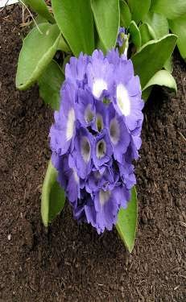
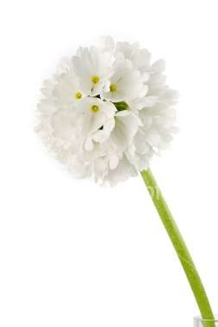
KkDd genotype will not produce malvidin due to the presence of D allele
Thus, white & blue colored flowers producing plants are obtained in the ratio of 13:3
Also known as dominant

Slide 40
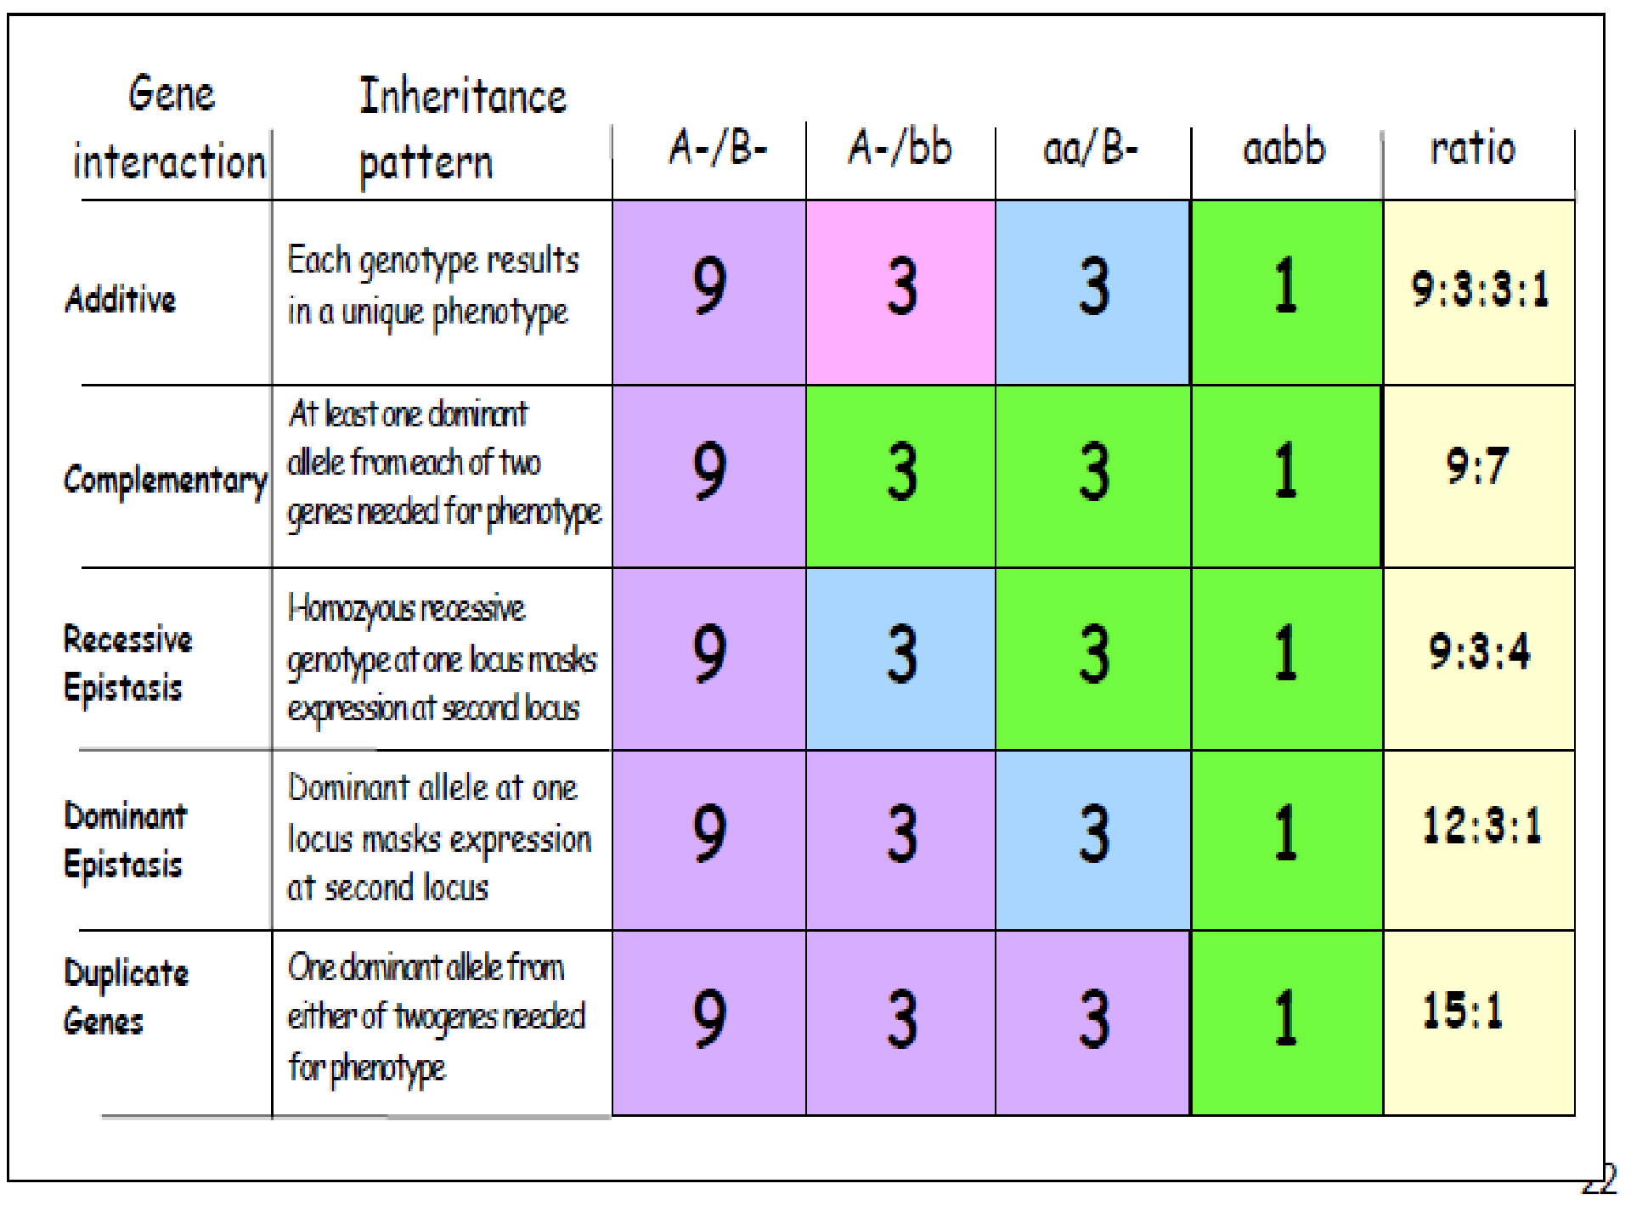

Slide 41

References:
Hartl,D.L., & Jones,W.E., (1998) “Genetics Principles and Analysis” ed: 4th Jones and Bartlett Publishers International London,UK, pp: 19,20,61-63
Miko, I., (2008) Epistasis: Gene interaction and phenotype effects. Nature Education 1(1)
Richards,J.E. & Hawley, R. S., (2010) “ The human genome” ed: 3rd Academic Press, pp: 31
Verma,P.S., & Agarwal,V.K., (2004) “Cell biology,
Genetics, Molecular Biology, Evolution and Ecology” ed:
₂₄th
S.Chand and Company Ltd,Ram Nagar, New
Delhi. Pp: 45-56

